Slide 1

PokerGame
Team 3
So Mi Choi, Bo Heon Jeong, Hanchen Li,
Sang Rhee, Yixin Wang, Yuying Wang
https://github.com/srhee91/PokerGame

Slide 2
Problem Motivation
Most of today’s poker games are web-based.
Requires internet connection
Requires account registration
Games played with total strangers

Slide 3
Project Goals
A LAN-based, non-web based Hold’em game.
Up to 8 players.
Can quickly jump in or out of games.
Clean and simple interface
2D graphics for cards and chips
Basic animations and sounds
Intuitive onscreen controls.

Slide 4
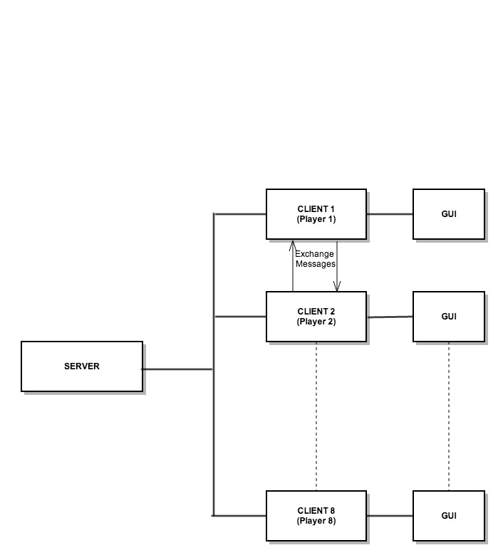
Client-Server Model

Slide 5
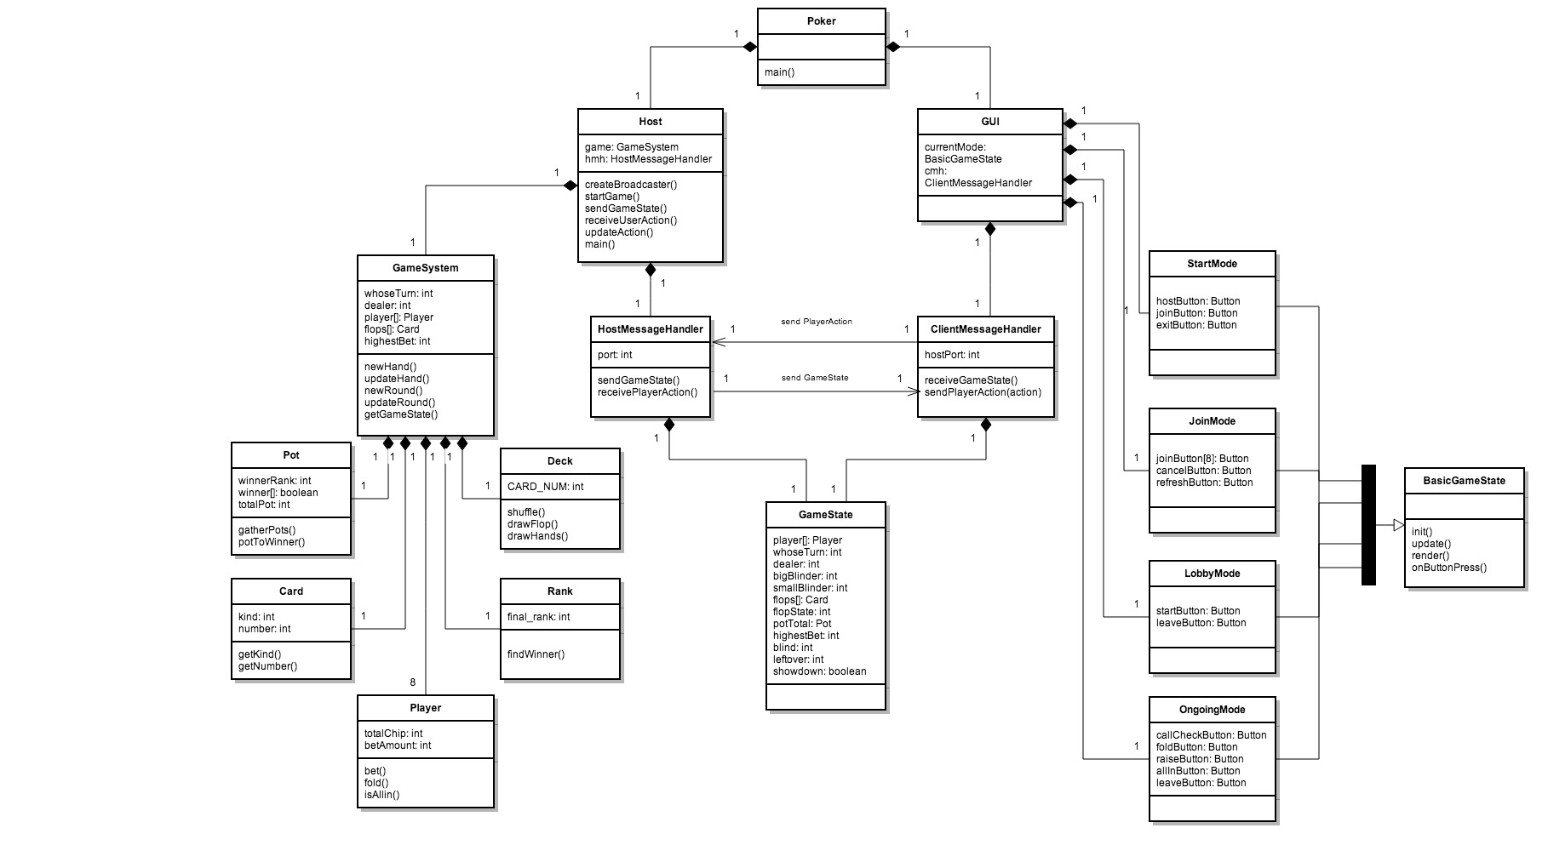

Slide 6
DEMO

Slide 7
Thank you!

